Slide 1


Teams Review Meeting
July-29-2021

Slide 2
Q3 Platform M4
Activities
ETL
Data Warehousing and Schema Design
Data Modeling
Metrics and Reports Development
Roles
Data Analyst
Data Engineer
Solution Architect

Slide 3
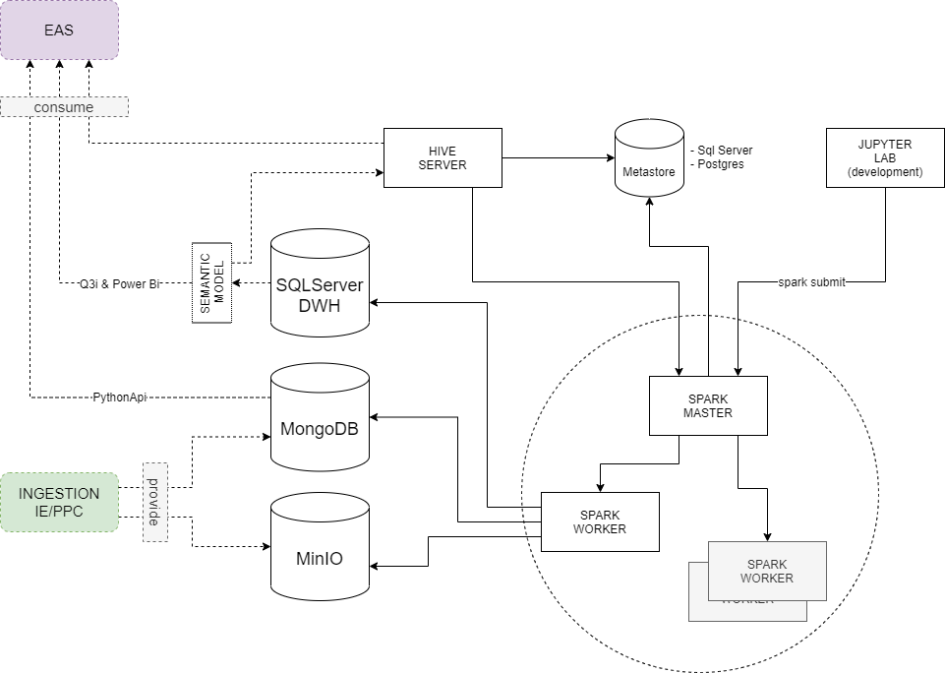
Q3 Platform M4 Architecture
Design for long term data storage
SQL-like languages for exploration of data sources
ETL development on a distributed environment – Horizontal Scaling
Schema design for efficient data retrieval
Semantic models on aggregated data
Different tools when data grows in volume

Slide 4
Q3 Platform Data Storage
Different LAYERS based on data aggregation level and analysis scope:
Bronze: Raw Data
Silver: Processed Row Data
Gold: Aggregated data
Different Data Storages for each layer:
Bronze:
Big raw Data
Unstructured
Storage: Object Storage
Silver:
Processed Big Data
Semi-structured
Storage: Object Storage / document DB / RDBMS
Gold:
Aggregated and structured Data
Storage: RDBMS

Slide 5
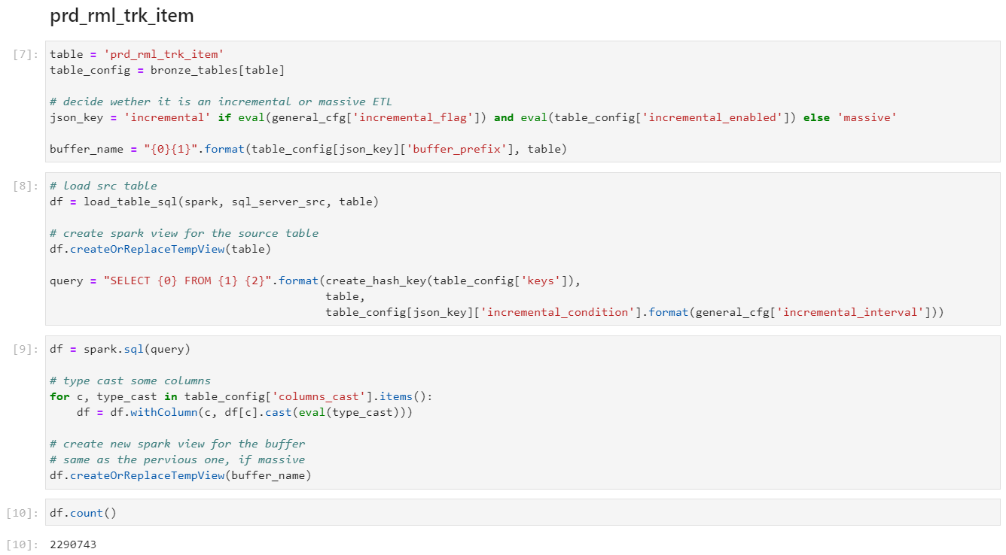
Q3 Platform Data Processing
ETL – Extraction Transformation & Loading
Tools/Libraries:
Pandas
Dask
Apache Spark

Slide 6
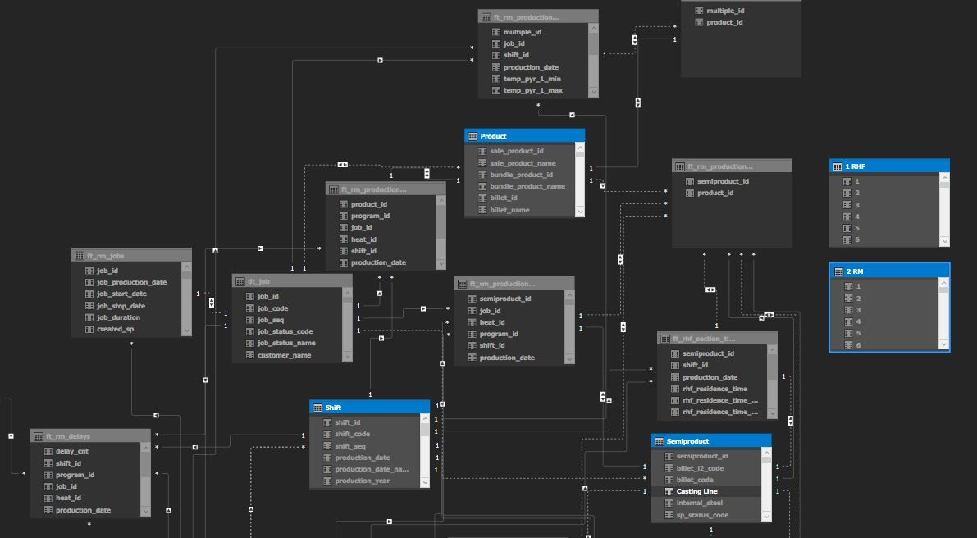
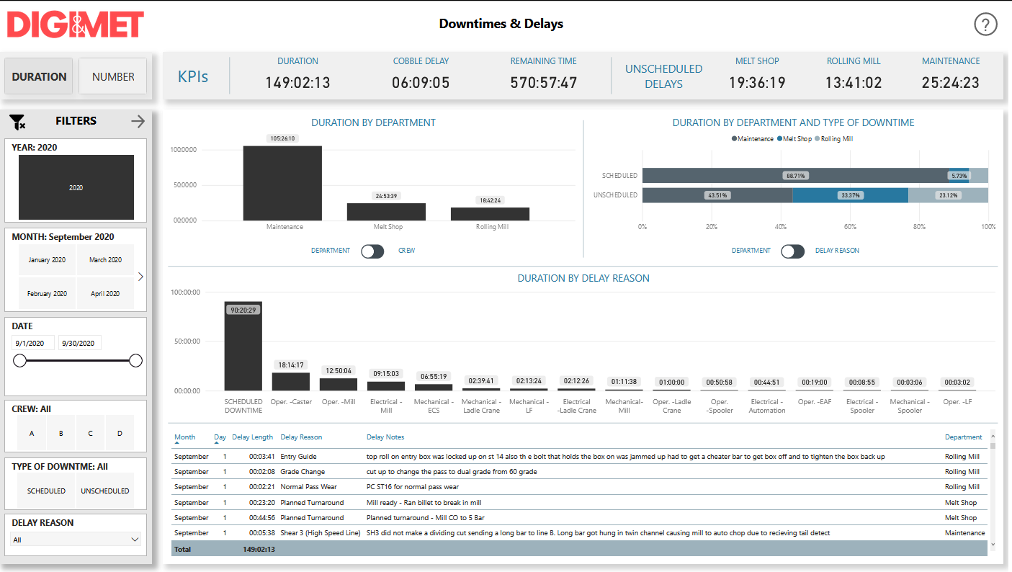
Q3 Platform Data Modeling
Semantic Model In Memory
Define relations between entities
Challenges:
Model in memory, not suitable for big data
Model and DWH standardization
Licensing and capacity planning

Slide 7
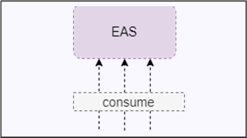
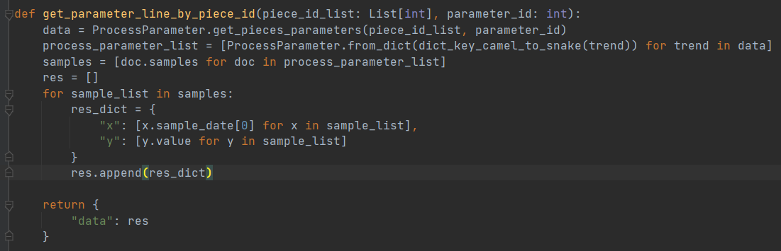
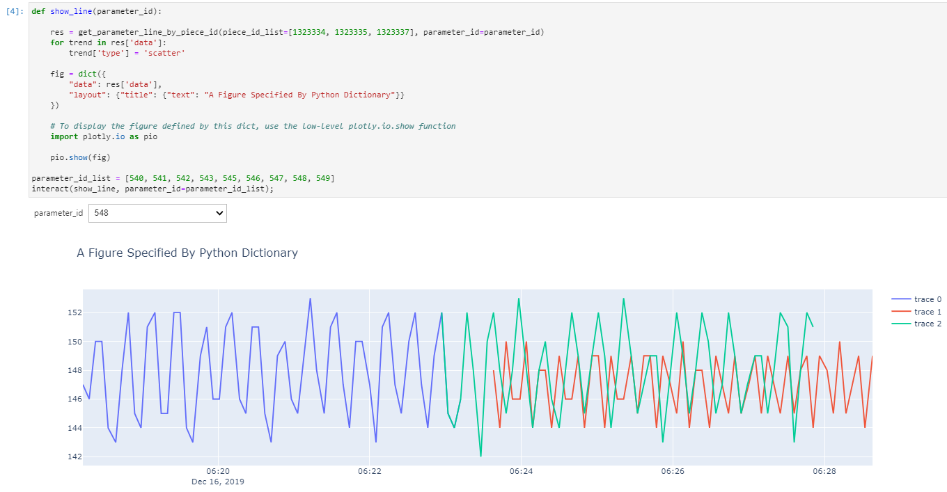
Q3 Platform Data Retrieve
Python Script Development
Executed through a common API developed by EAS Team

Slide 8
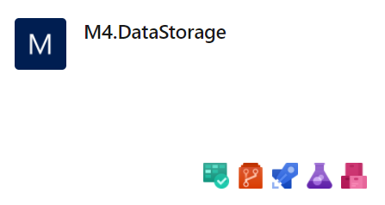
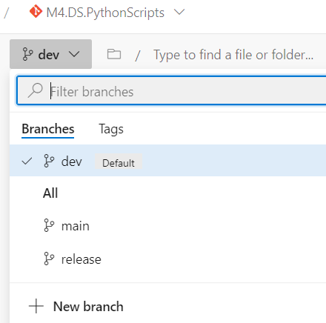
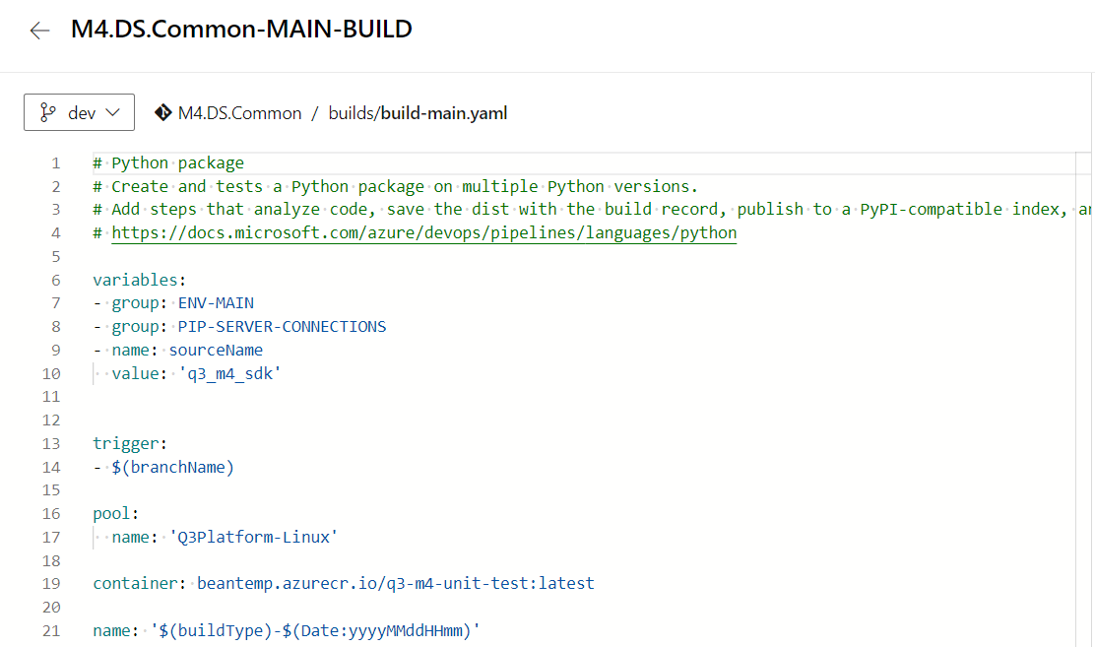
Q3 Platform DevOps
Source Control
Pull Requests
Pipelines
Unit / Integration / Performance Test
Docker images development and publishing
Libraries Versioning and publishing

Slide 9

GRAZIE
per l’attenzione
www.beantech.it
www.beantech.it/academy
www.beatech.it/blog

